Slide 1
From DataCenter to
Cloud: Automating F5
Big-IP with Terraform
Muhammad Shoaib

Slide 2

Agenda
Introduction
F5 and Paciolan
Data center to the cloud
Architecture diagram
Prerequisites
Demo

Slide 3



Muhammad Shoaib
Director of Edge and Infrastructure Security
Paciolan is your one-stop shop
For ticketing, fundraising, marketing solutions and customer engagement

Slide 4
Data Center Architecture
WAF
Cisco / Palo Alto
F5 BIG-IP pair
EKS
App1
Web Farm
App2
ECS
App3

Slide 5
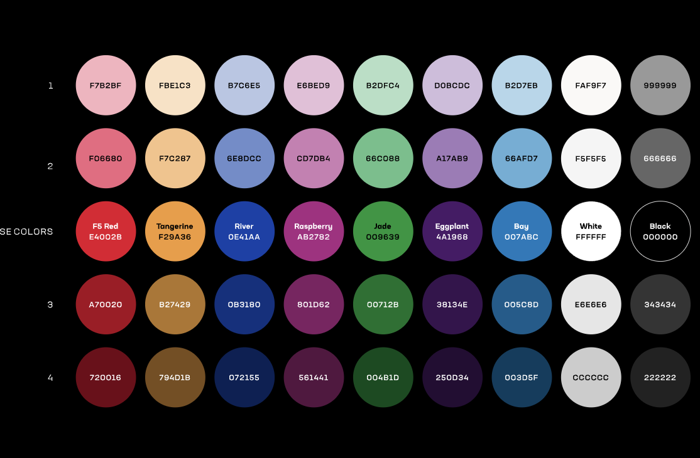
Cloud Architecture
CloudFront
AWS WAF
Origin
Origin Group VPC Origin
nlb-1
Target group
nlb-2
Target group
F5 BIG-IP-1
Virtual
F5 BIG-IP-2
Virtual
EKS
App1
Web Farm
App2
ECS
App3

Slide 6



Prerequisite
F5 Reg key
BIG-IP VE AMI
AWS account
VPC
SSH Key Pair
3 subnets
Security group
Terraform

Slide 7
The Phases - Launch VE
Launch BIG-IP AMI as EC2
Create 3 interfaces
Create Secondary IP for BIG-IP VIP
Reset admin password
Phase 1
Install license
Disable setup utility
LTM Resource Provision
Meta Data for Phase 2

Slide 8
The Phases - Networking
Create VLANs
Phase 2
Create self IPs
Add default route
Meta Data from phase 1

Slide 9
The Phases – Virtuals / Pools
Launch BIG-IP AMI as EC2
Create nodes
Create monitor
Create pools
Create profiles
Phase 3
Create virtual
Create iRule
Create DataGroups
Meta Data from phase 1

Slide 10
Phase - 1 Launch VE

Slide 11
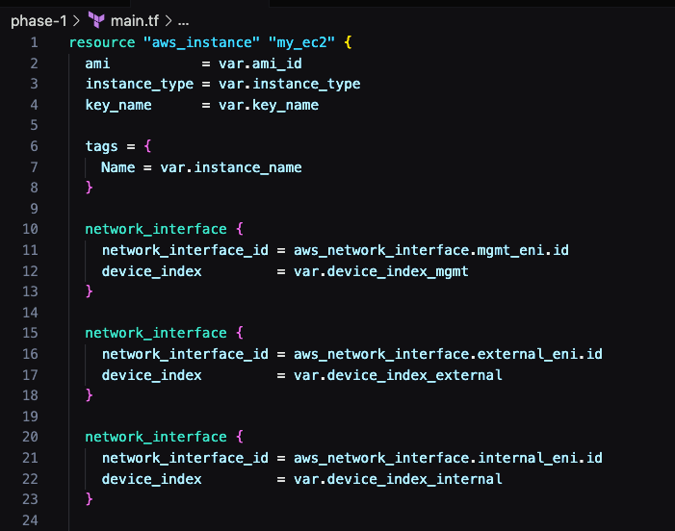
Launch BIG-IP AMI as EC22
3 Interfaces
Management
External
Internal

Slide 12
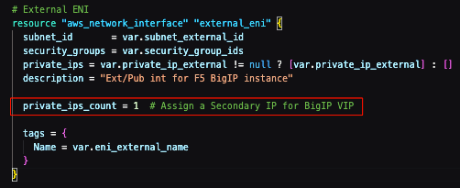
ENIs
ENIs
3 Self IPs
Management
External
Internal
IP for a Virtual

Slide 13
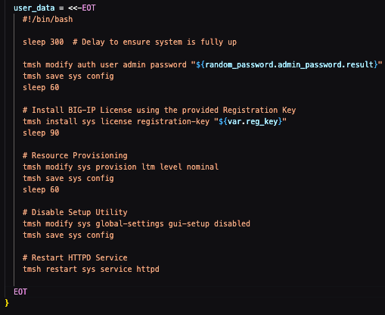
user_data
Password reset
Install license
Disable setup
Resource provision
Meta Data for phase 2 & phase 3

Slide 14
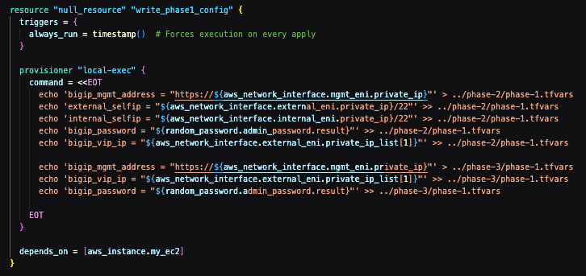
Phase - 1 Meta Data
MGMT IP
Self IPs
Admin password
VIP IP

Slide 15



Phase - 1 execution

Slide 16
Phase - 2 Networking

Slide 17
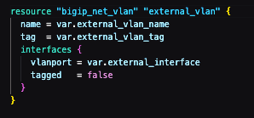
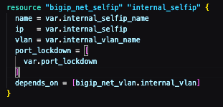

Networking
VLANs
Self IPs
Route

Slide 18
Phase - 2 execution

Slide 19
Phase - 3 BIG-IP Config

Slide 20
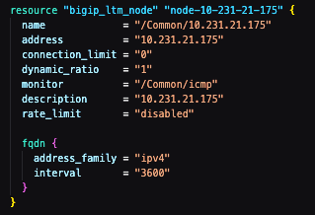
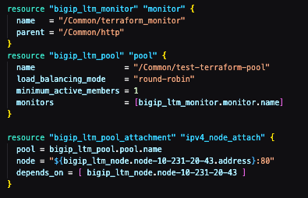
Config
Nodes
Monitor
Pools

Slide 21


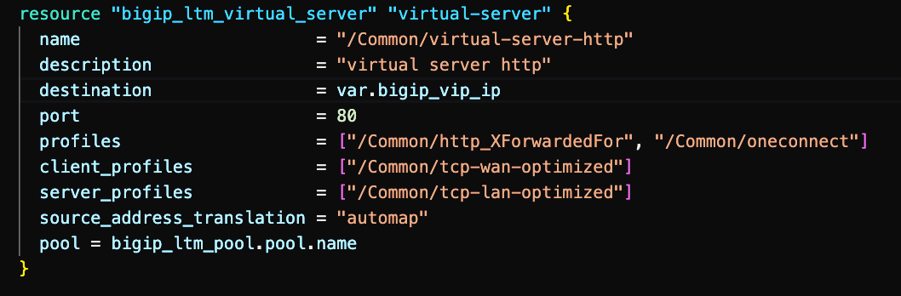
Config
Profiles
iRules
Virtuals

Slide 22
Phase - 3 execution

Slide 23
What’s next

Slide 24



Cloudfront
VPC Origin
VPC Origin
Origin
NLB
NLB
BIG-IP
BIG-IP

Slide 25

Q &A Thank you

Slide 26
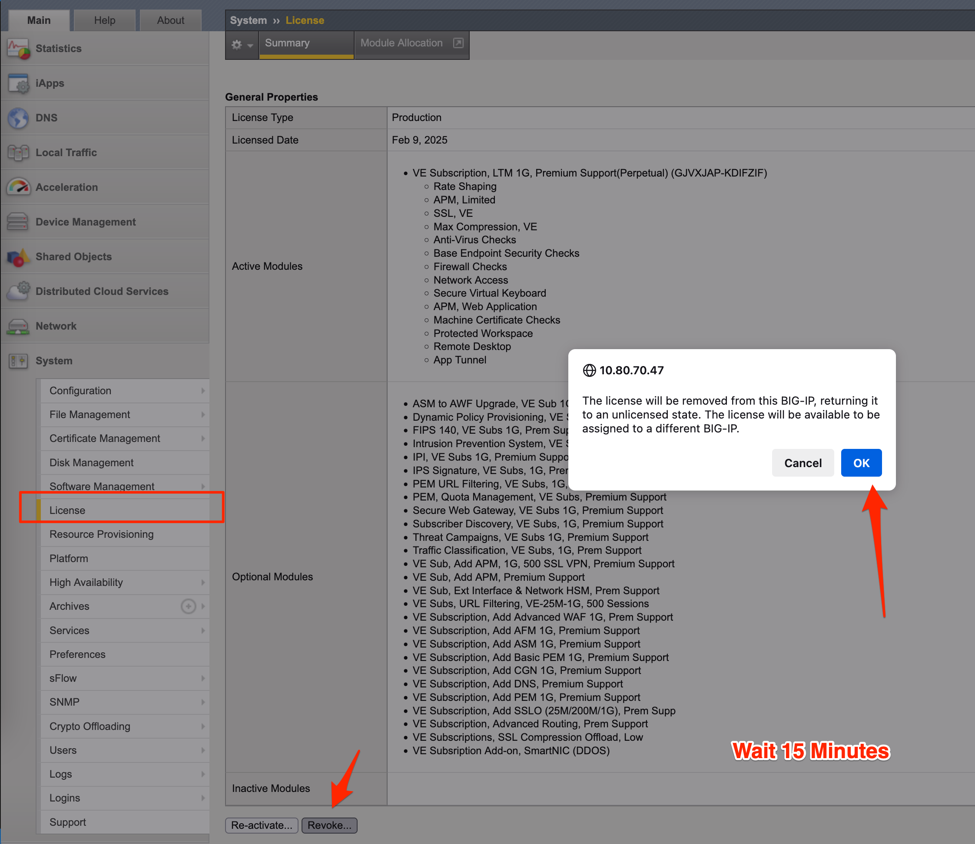
How to Revoke a License
System >> License
Revoke
Wait 15 Mins

Slide 27

https://github.com/mshoaibshafi/f5appworld25
Link

